Slide 1
Git - GitHub training
By @orgutier
Proprietary presentation from https://github.com/orgutier/GithubTraining

Slide 2
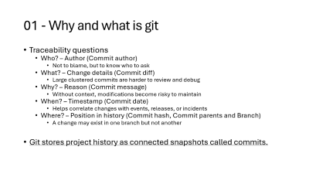
Agenda part 1 - Fundamentals
01 | Why and what is git
02 | Git use case
04 | Git staging area
03 | Git commits
05 | Git tree
06 | Git branches

Slide 3
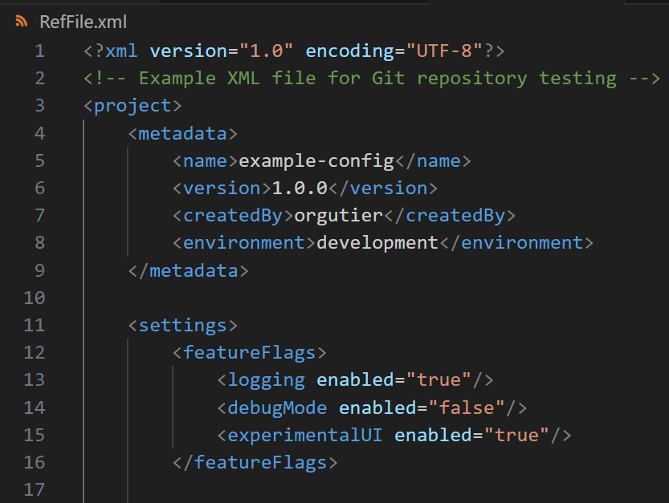
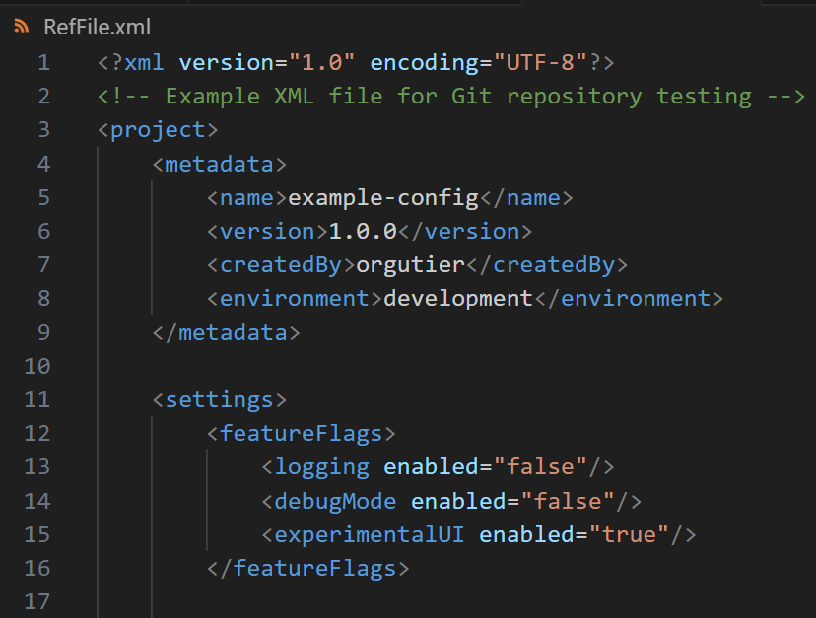
01 - Why and what is git
Your project has a configuration file, and someone decides to change a single parameter

Slide 4
01 - Why and what is git
Traceability questions
Who? – Author (Commit author)
Not to blame, but to know who to ask
What? – Change details (Commit diff)
Large clustered commits are harder to review and debug
Why? – Reason (Commit message)
Without context, modifications become risky to maintain
When? – Timestamp (Commit date)
Helps correlate changes with events, releases, or incidents
Where? – Position in history (Commit hash, Commit parents and Branch)
A change may exist in one branch but not another
Git stores project history as connected snapshots called commits.

Slide 5
02 - Git use case
Git is great for
*.xml
*.c
*.cpp
*.py
*.json
*.txt
*.asc
*.sh, *.bat
Etc…
As long as the file is codified as text format
E.g. UTF-8, UTF-16, ISO-8859-1
Git is blind for
*.vbf
*.blf
*.exe
*.msi
*.bin
Etc…
Non-text files such as artifacts, executables and binary files

Slide 6
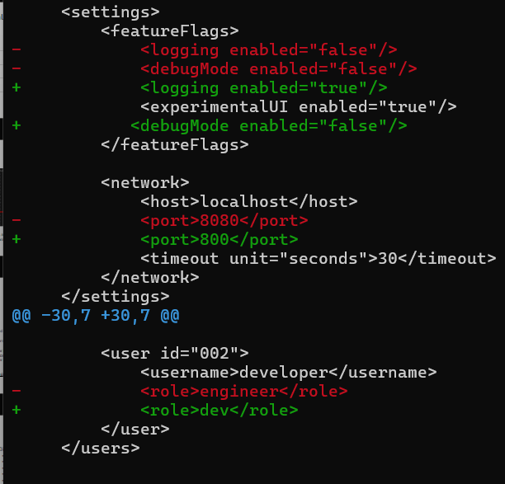
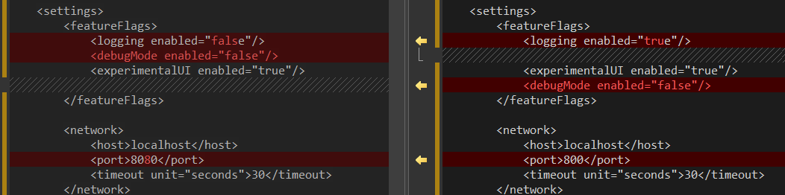
02 – Git use case
When you modify a line in a text file, git considers you deleted and added a new line
> git diff <file>

Slide 7
02 – Git use case
If you move one line to another place in the same file, git will consider you deleted it and you created a new line

Slide 8
02 – Git use case
> git diff
Git primarily represents modifications as line deletions and insertions. (What), Some diff engines may be able to detect moves of blocks

Slide 9
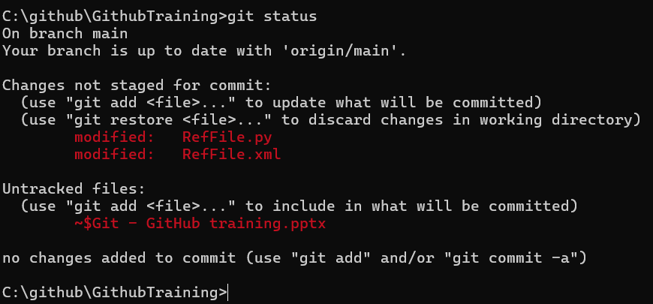
03 – Git staging
Git status provides details of what changes you are preparing to create a commit; this is not tracked unless you complete the commit
Branch your HEAD is pointing at
Up to date from last fetch
Files that have at least one active commit in history and are different from current HEAD
Files that do not have active commits in history
> git status

Slide 10
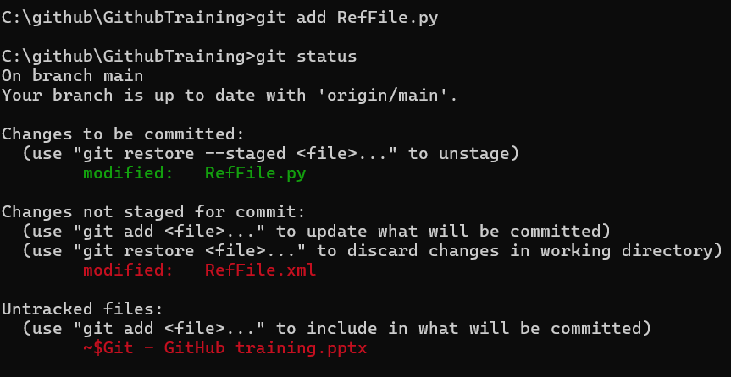
03 – Git staging
Add file to staging area
Files in staging area prepared for potential commit
> git add <file>

Slide 11
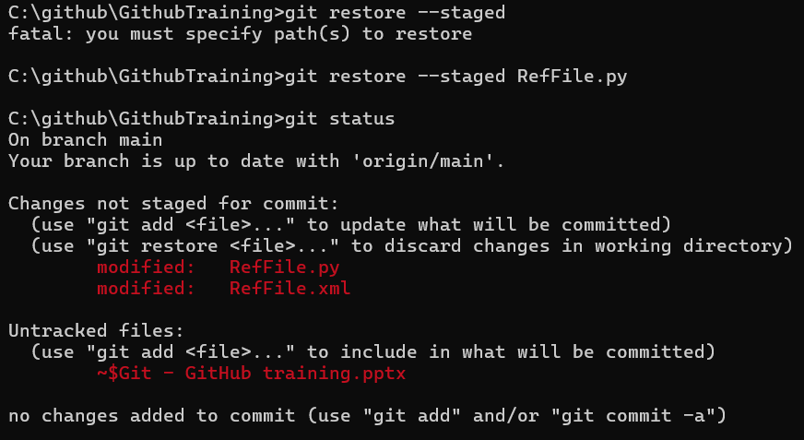
03 – Git staging
Removes file from staging without modifying the file itself
File goes back to not staged area
> git restore --staged <File>

Slide 12
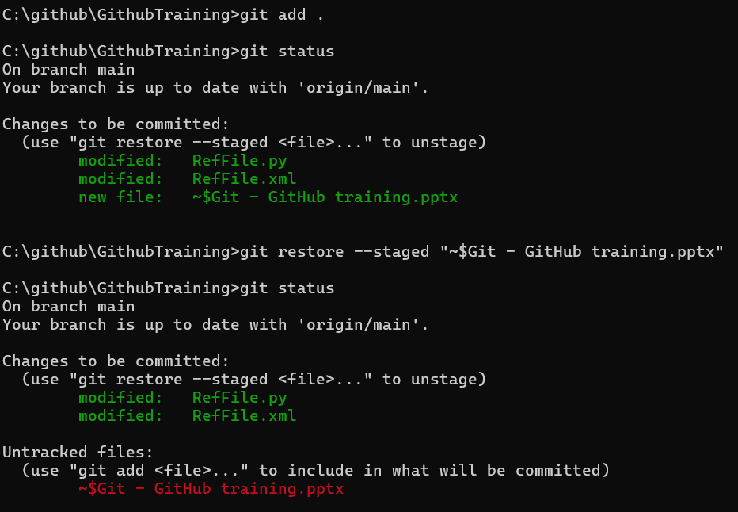
03 – Git staging
Adds all files in current directory to staging
All files in current directory not staged
Remove those files you do not need to commit
Confirm the files you want to commit
> git add .

Slide 13
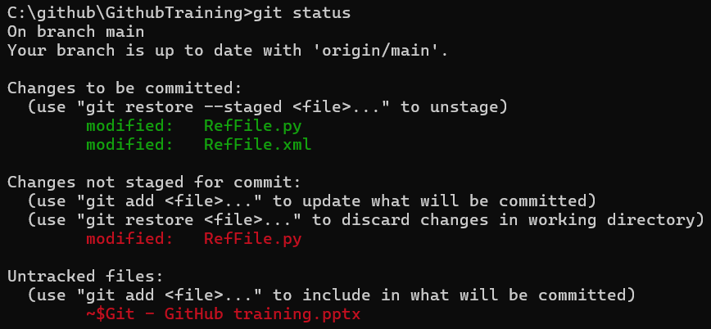
03 – Git staging
One file can be in staging and untracked section, that means you staged that file and then made another change. That new change relative to staging is the one untracked

Slide 14
04 – Git commit
Commit triggers the snapshot of the repository with the content of your stage, adding metadata for traceability
> git commit –m “Message”
[branch hash]
Hash is a statistically unrepeatable id of your change, consider it a fingerprint of your commit
Details of what changed in your commit

Slide 15
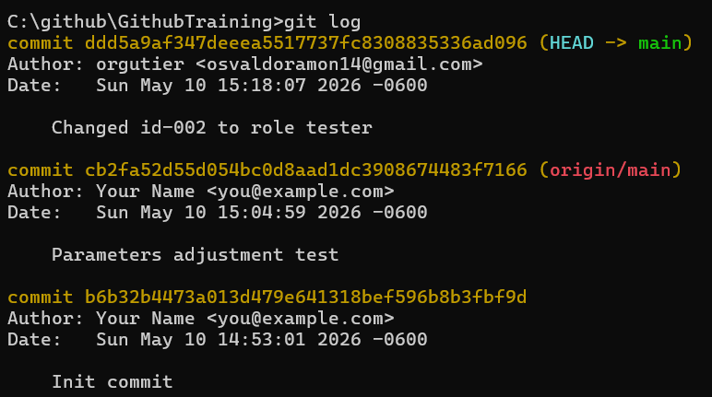
04 – Git commit
Git diff will make a comparison within current Workspace and commit you provide
Where?
Who?
When?
Why?
> git log

Slide 16
04 – Git commit
> git diff <Commit A> <Commit B> <File>
What needs A to become B?
Option --stat gives a summary with no detailed diff per file
Git have many ways to provide metadata of changes, git diff, git log etc… (What)

Slide 17
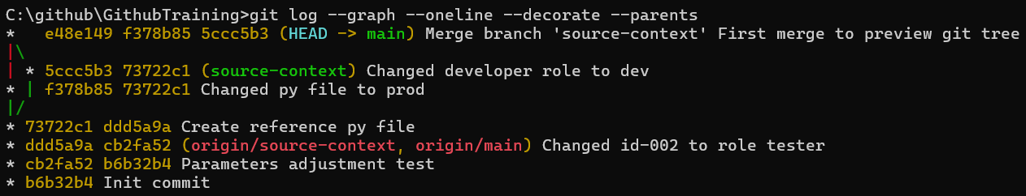
05 – Git tree
Commit hash – Self id in history
Parents - Where I come from
> git log --graph --oneline --decorate --parents

Slide 18
06 – Git branches
A branch is a movable pointer to the latest commit in a line of history.
Commits are immutable. Branches move
Older
Newer
…
ddd5a9a
73722c1
f378b85
e48e149
origin/source-context
5ccc5b3
main
origin/<branch>
These represent the last known state of remote branches.
origin/main
HEAD usually points to the currently active branch or commit
HEAD
Branches do not store commits. They only point to a commit.
source-context

Slide 19
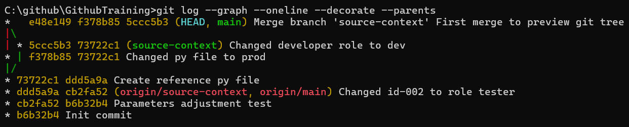
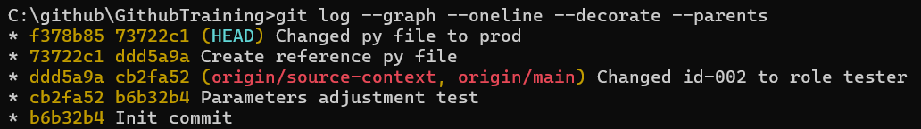
06 – Git branches
When HEAD does not point to a branch, it is known as DETACHED HEAD
When HEAD points to a branch It will include the arrow to that branch
When HEAD points to a commit, it will be listed isolated in the branch list
HEAD can point to a commit that do not have a branch there, this use case helps to track past historic states of the repo

Slide 20
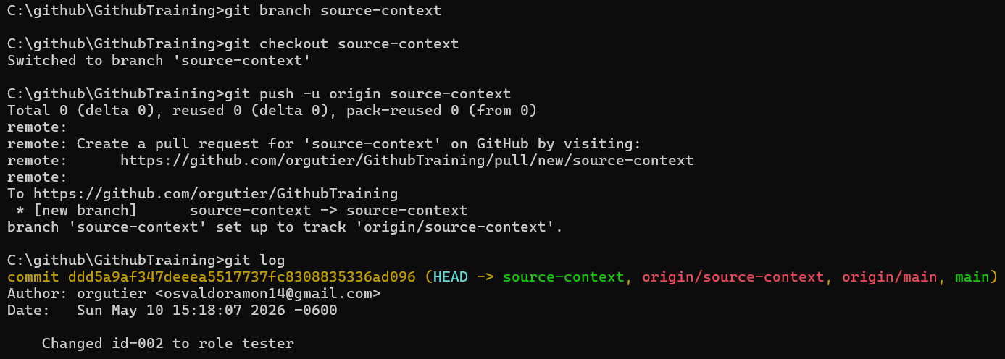
06 - Git branches
Branch creation
Branch upstream creation
HEAD points to new branch
> git branch <branch name>
> git checkout <branch name>
> git push -u origin <branch name>

Slide 21
07 - Github
 | Git | GitHub
Type | Version Control System | Web platform / Hosting service
Where it runs | Your computer (local) | Cloud (github.com)
Main Purpose | Track changes & create commits | Collaboration & Sharing
Key Features | Commit, Branch, Merge, Staging | Pull Requests, Issues, Code Review, Actions

Slide 22
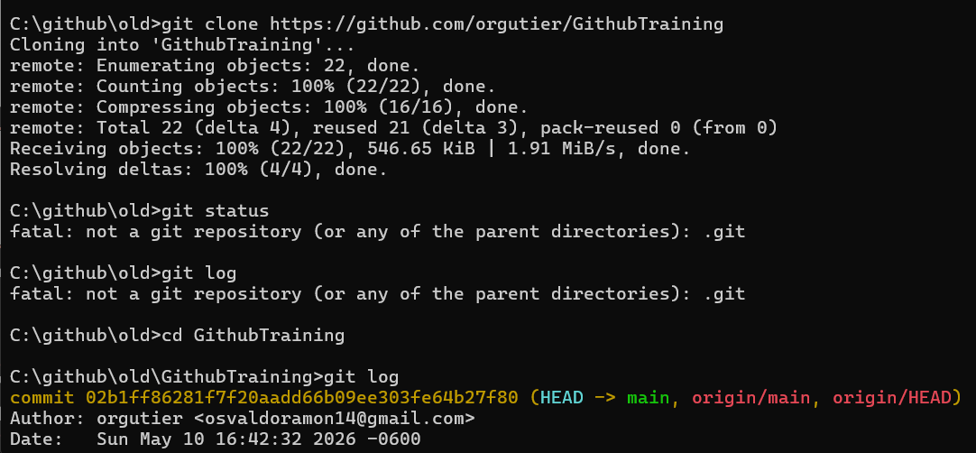
07 - Github
Downloads remote repository in current folder with repo name as folder name
> git clone <repo url>

Slide 23
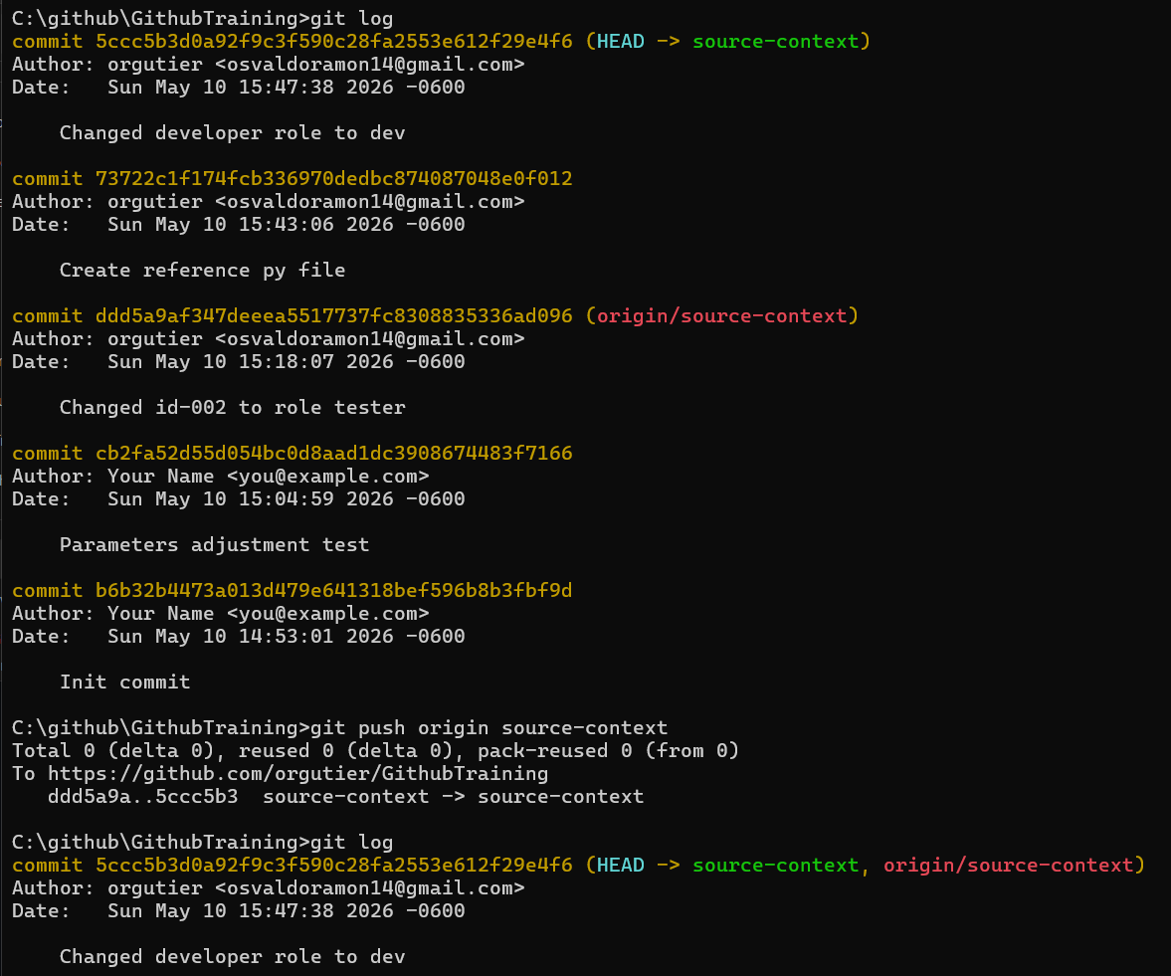
07 - Github
Last tracked remote change
Pushes commits from local branch that are ahead of remote branch (origin)
New tracked remote change
> git push origin <branch>

Slide 24
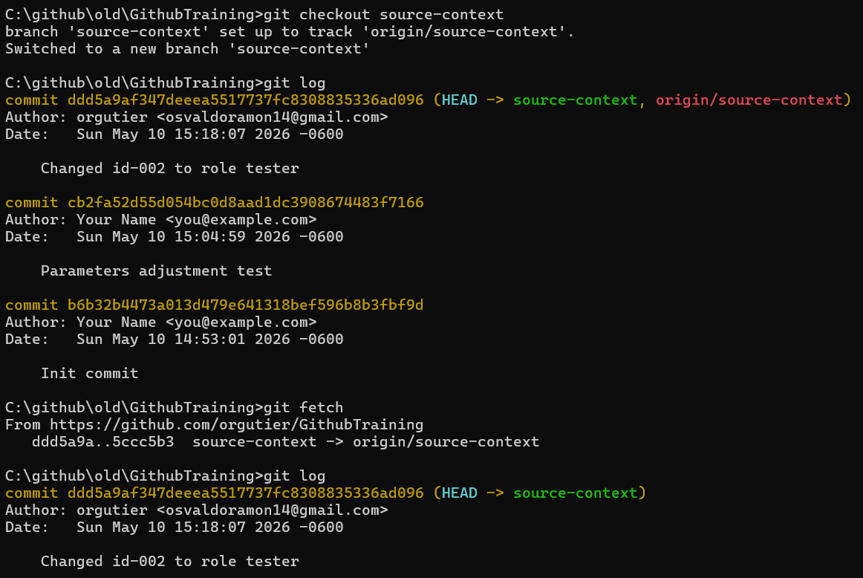
07 - Github
Last known state of the repo
Updates git tree without modifying work directory nor HEAD/local branch
Commits ahead that remote branch is with respect to local last known state
> git fetch

Slide 25
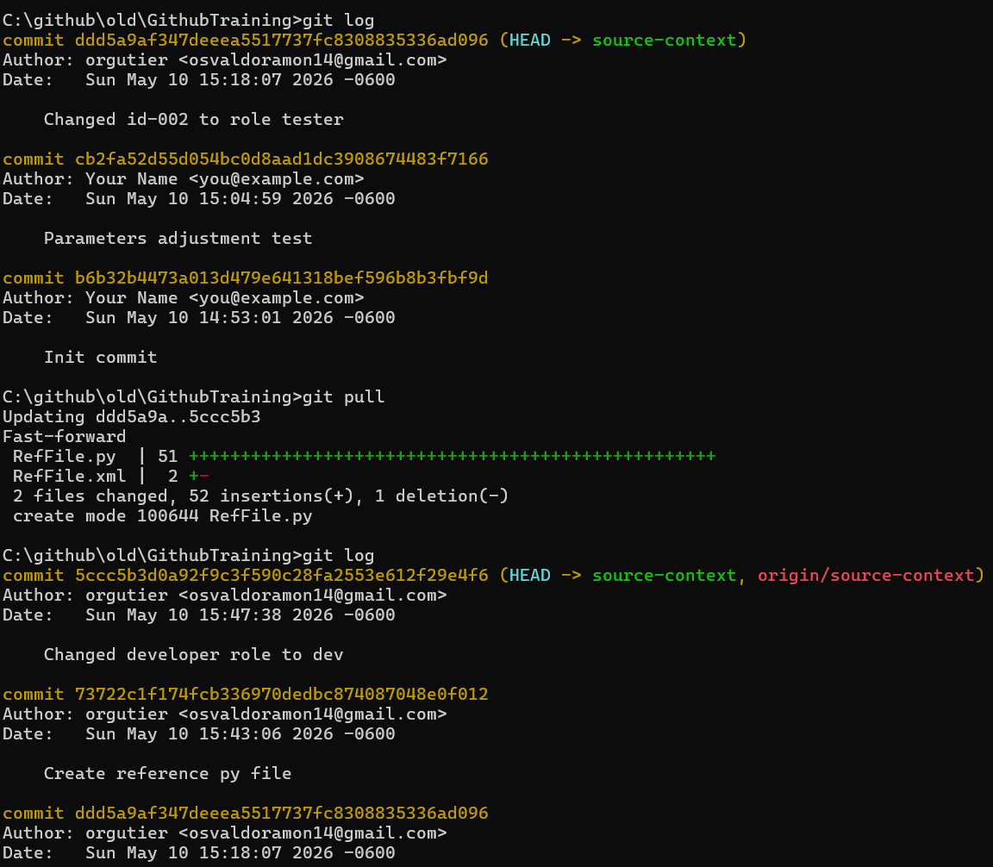
07 - Github
Update git tree (git fetch) and merge changes to my work directory (git merge)
Branch updates with last commit the branch points at in remote repo
> git pull

Slide 26
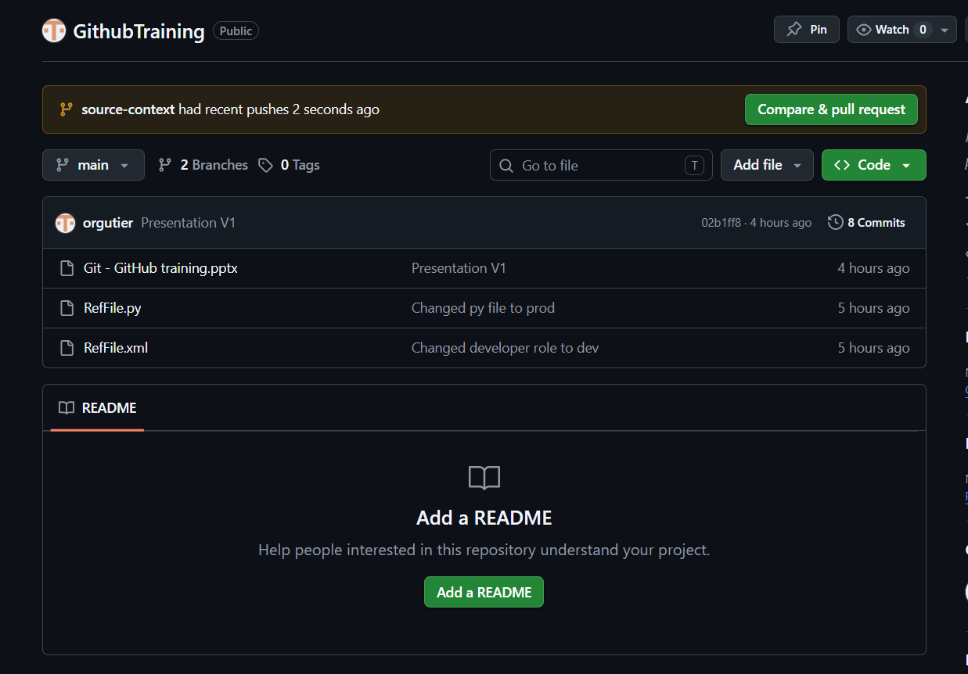
07 - Github
Click to create pull request

Slide 27
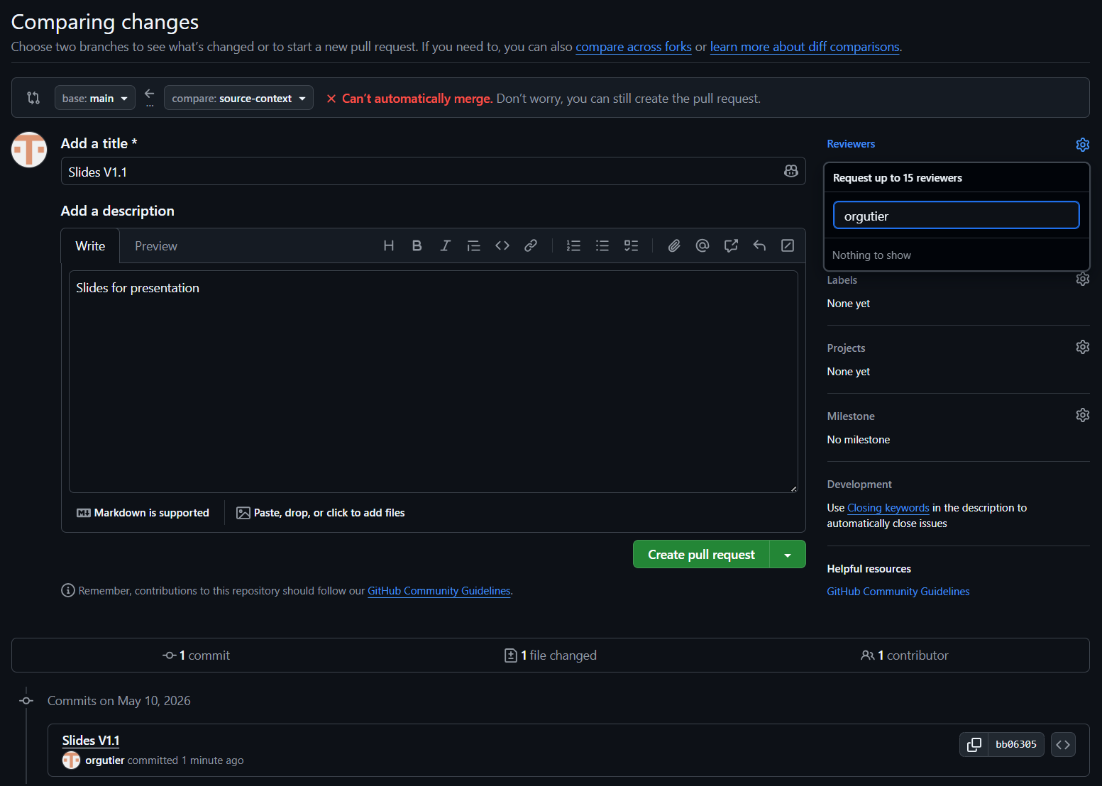
07 - Github
Fill mandatory fields and create pull request

Slide 28
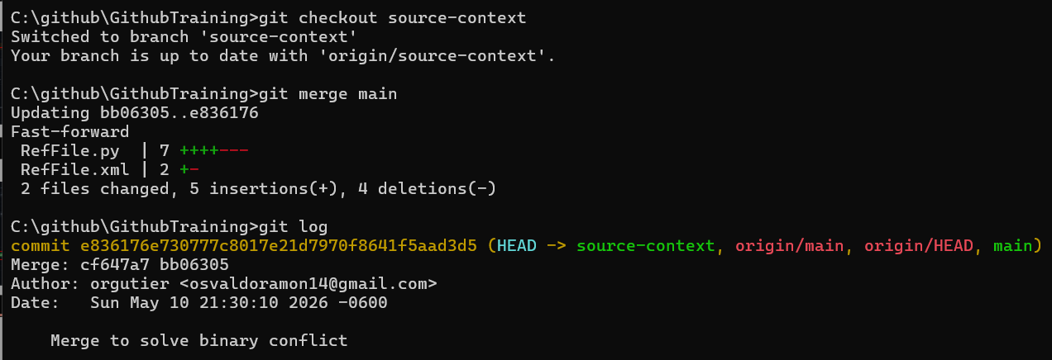
07 - Github
Go to branch you want to get updated
Merge main branch to source-content
> git merge <branch>

Slide 29
Summary
Basic Commands
git status # Check current state
git add . # Stage all changes
git commit -m "message" # Commit staged changes
git log --oneline --graph # View history
Branching
git branch <name> # Create branch
git checkout <name> # Switch branch
git checkout -b <name> # Create + switch
git push -u origin <name> # Push + set upstream
Sync with GitHub
git clone # Download remote repo
git pull # Fetch + merge
git push # Upload changes
git fetch # Update remote info
Useful Extras
git restore --staged <file> # Unstage a file
git diff # See changes
git log --stat # Summary of changes

